Slide 1
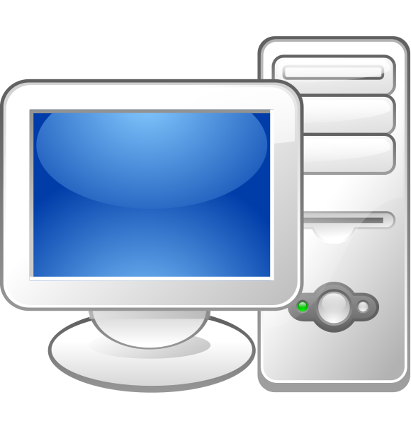

Download report
Follow these steps . . .

Slide 2
Important Information:
Tungsten allows you to download the list of invoice details on to a spreadsheet for various analysis.
The report has the remittance advise number by each paid invoices using which you can identify all the invoices paid in a payment and confirm the payment.
You can use this report to cross check with the list of invoices you want to query or know the status.
If you do not see an Invoice reflecting on the portal or in the report, this means Unilever has not received such invoice(s). You may have to resubmit the invoice to Unilever. (Please note : for Paper invoice you will have to keep the transit time in mind from the time you parcelled/couriered to Unilever)

Slide 3


Step 1 : Login to Tungsten Network Webpage
https://portal.tungsten-network.com/Login.aspx?ReturnUrl=%2f

Slide 4
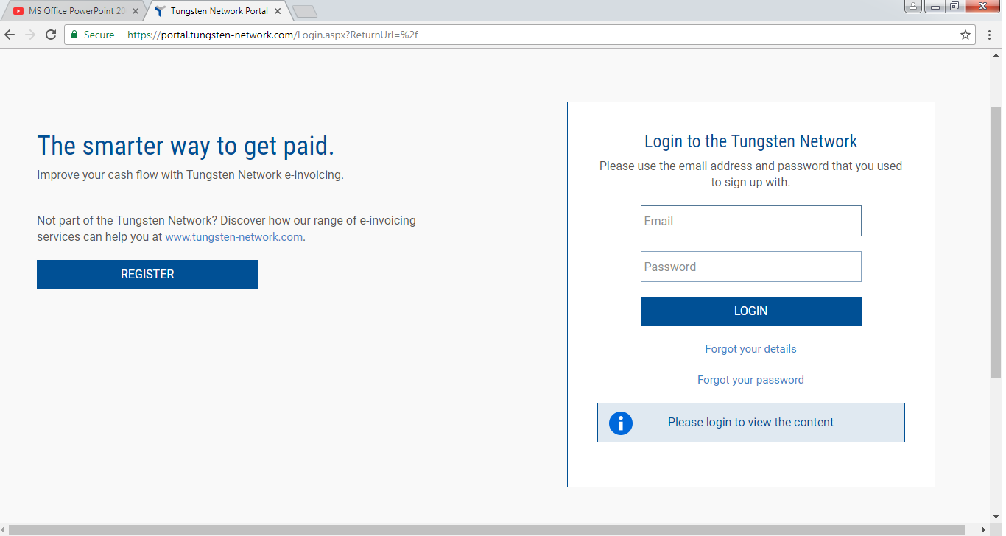

Step 1 : Login to Tungsten Network Webpage
https://portal.tungsten-network.com/Login.aspx?ReturnUrl=%2f
Enter your login ID
Enter your password

Slide 5
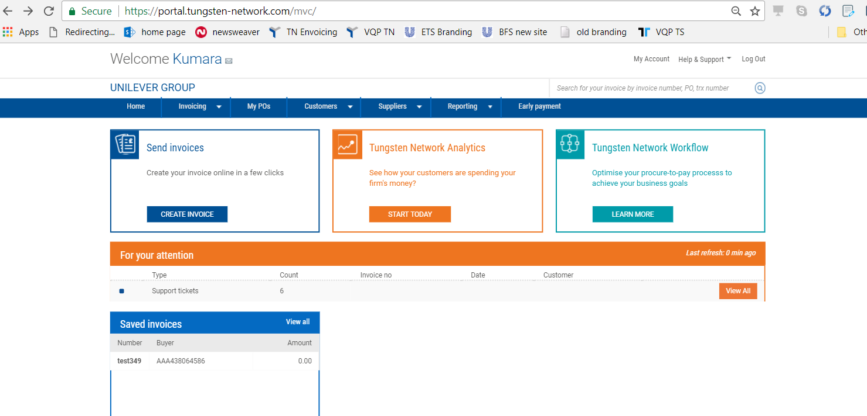
Step 2 : Click on “Reporting” drop down
Click on Reporting

Slide 6
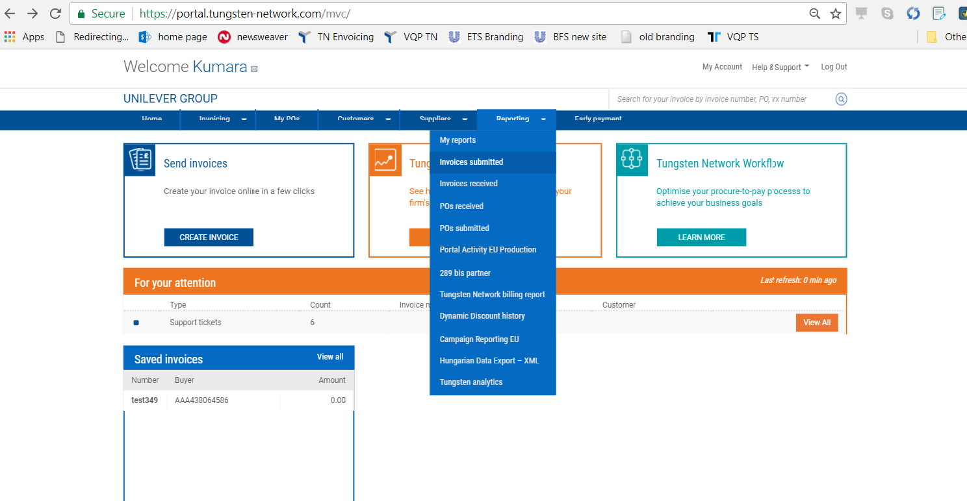
Step 3 : Select “Invoices Submitted” in the drop down
Select Invoice Submitted

Slide 7
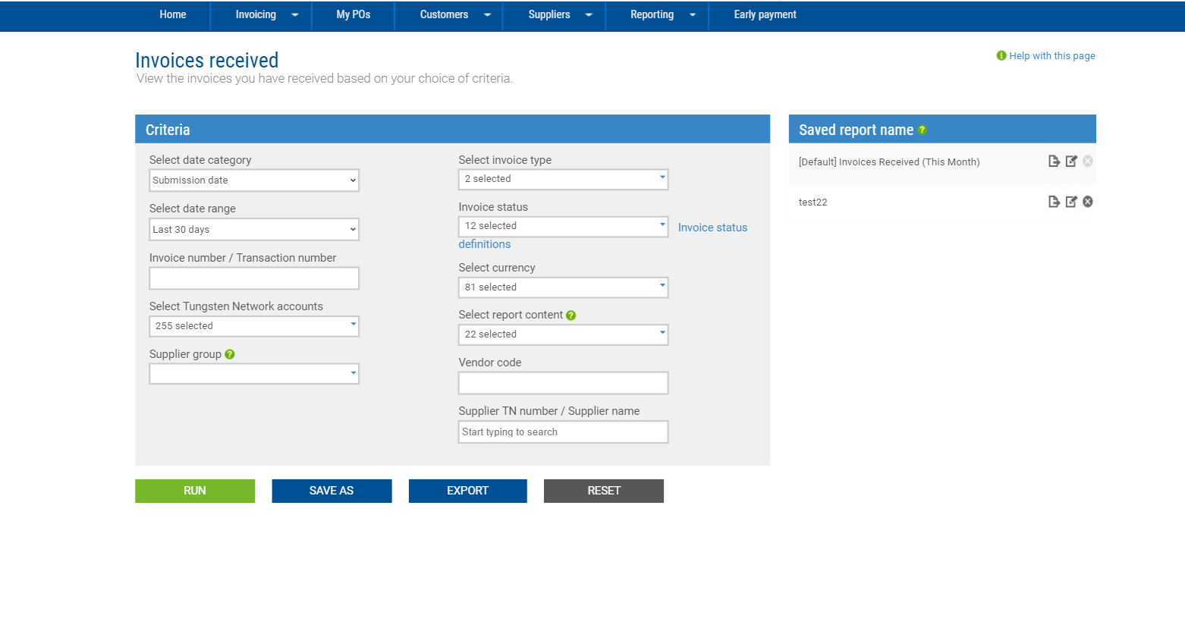
Step 4 : Enter the “Criteria” and click “Run”
Apply required filters
Click on Run

Slide 8
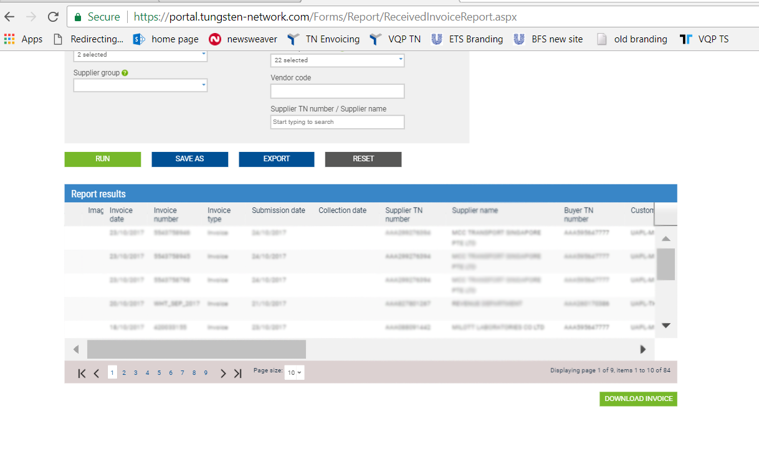
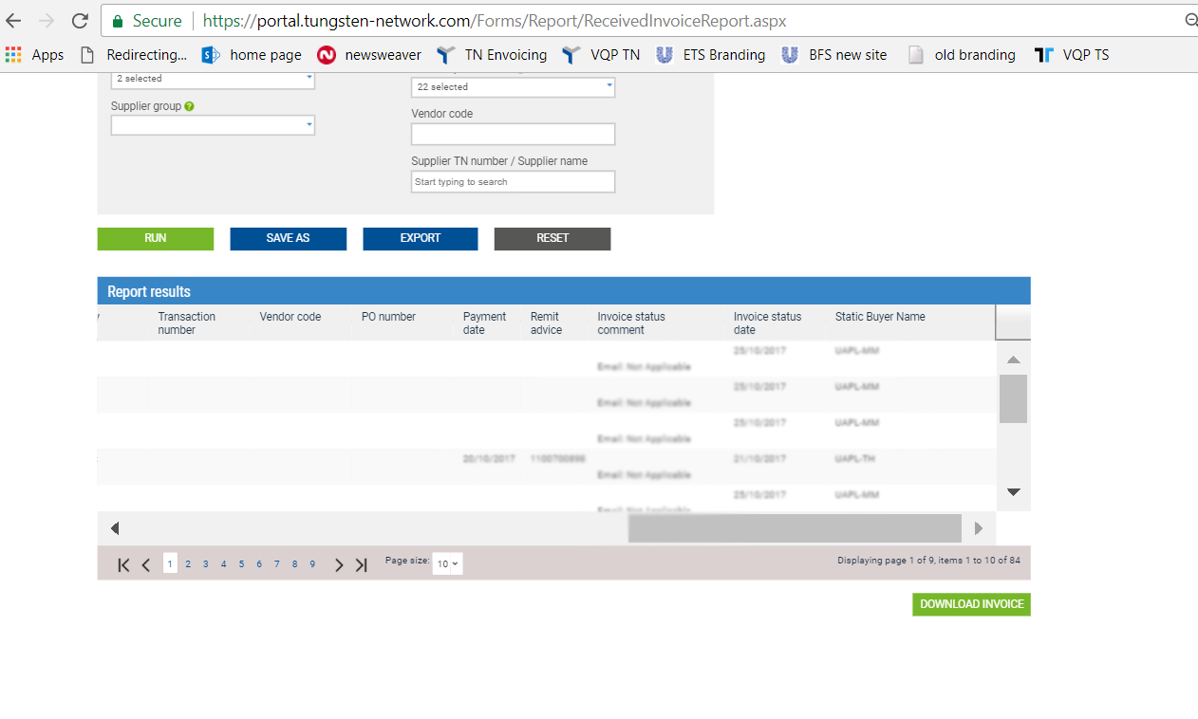
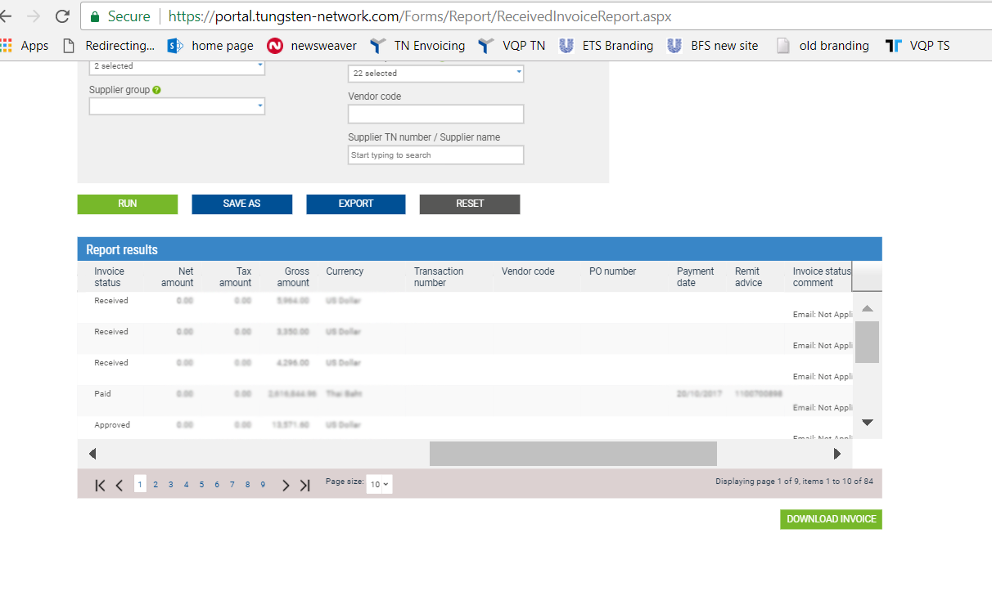
Step 5 : Check the “Report Results”

Slide 9
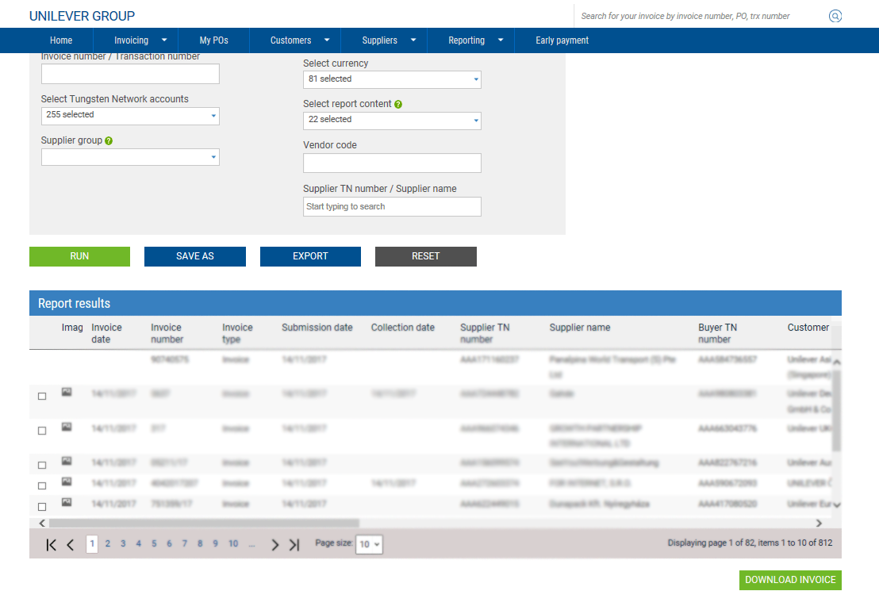
Step 6 : Click on “Export” button to save
Click on Export to download the report

Slide 10
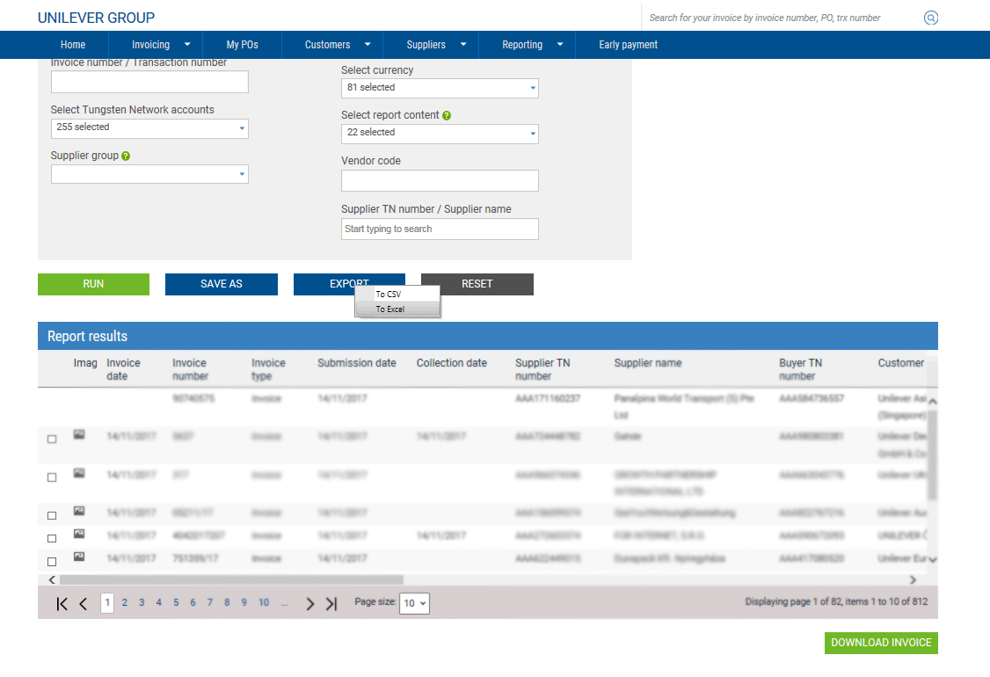
Step 6: Choose Export format in the dropdown
Select the file format you want to download

Slide 11
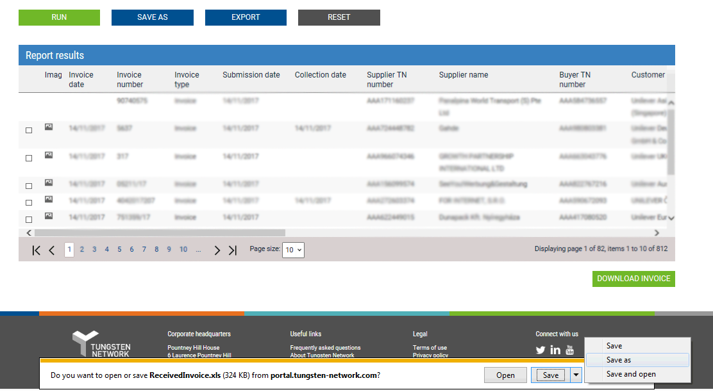
Step 7 : Click on “Save as”
Click save to confirm download Select Save as to save the file to the desired location

Slide 12
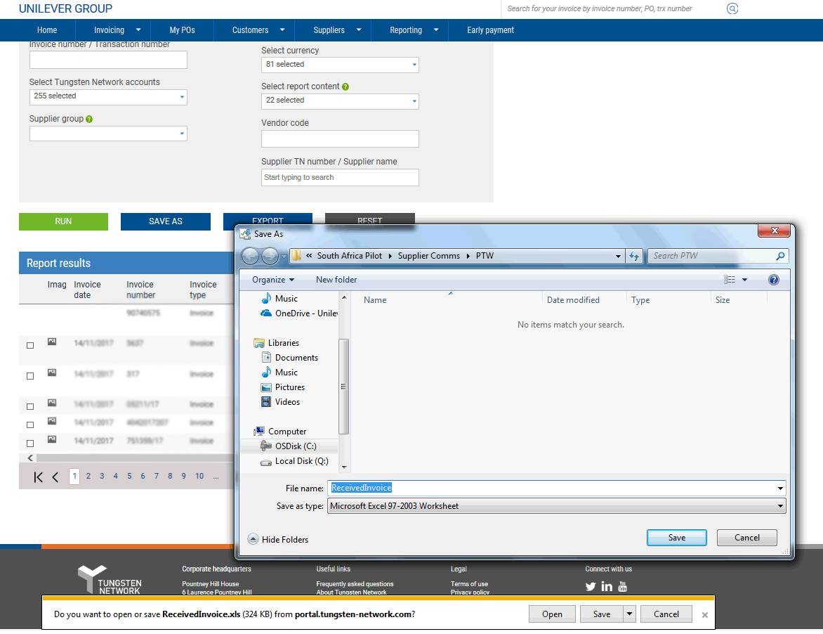
Step 8 : provide new “File name”
Provide the file location and file name to save the report

Slide 13
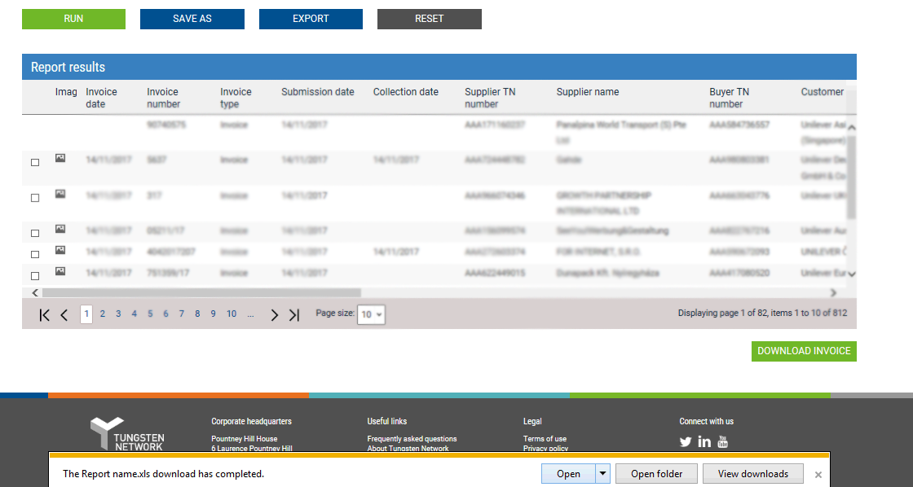
Step 9 : Click on “Open” to check the final report
Click here to open the downloaded file

Slide 14
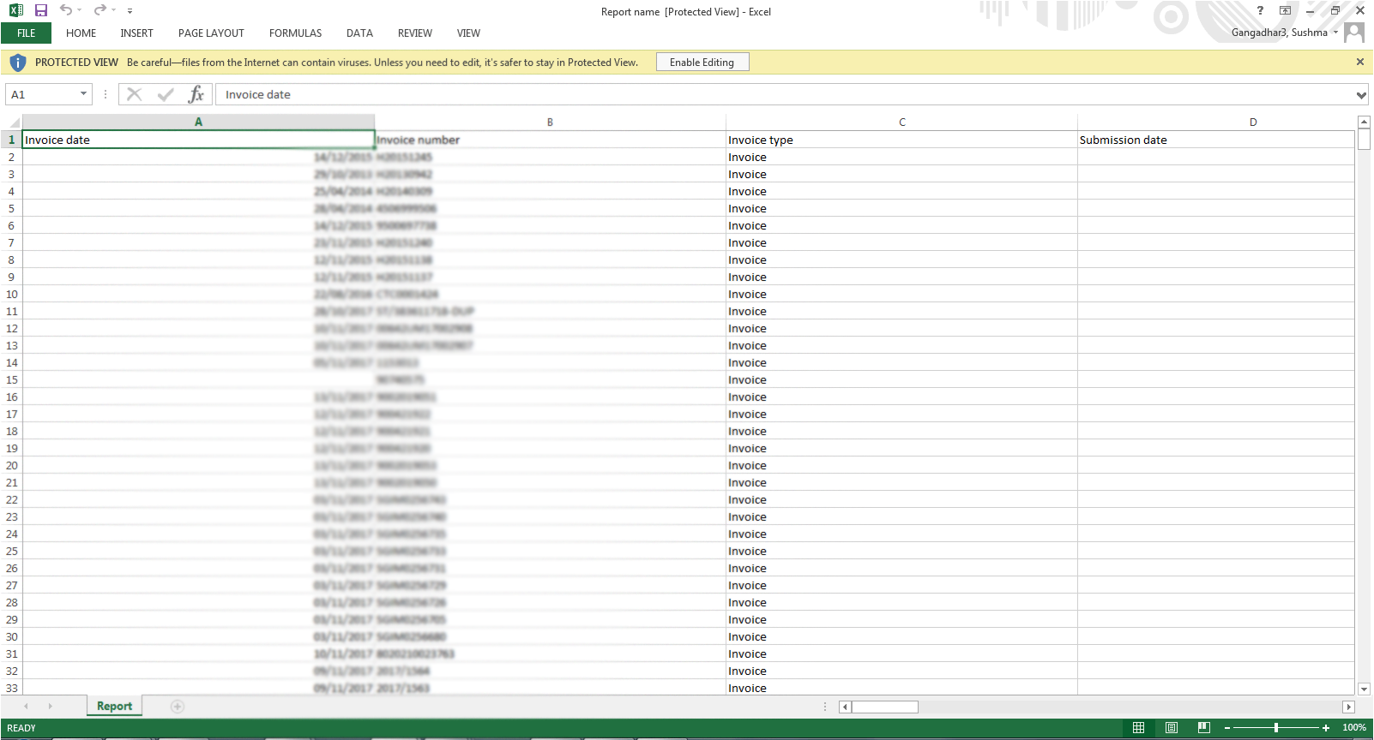
Step 10 : Get the final report
Downloaded Report

Slide 15
Thank you

